Slide 1

Task- 2 Predicting customer buying behaviour
By:
Gnaneshwari Mahimaluru

Slide 2
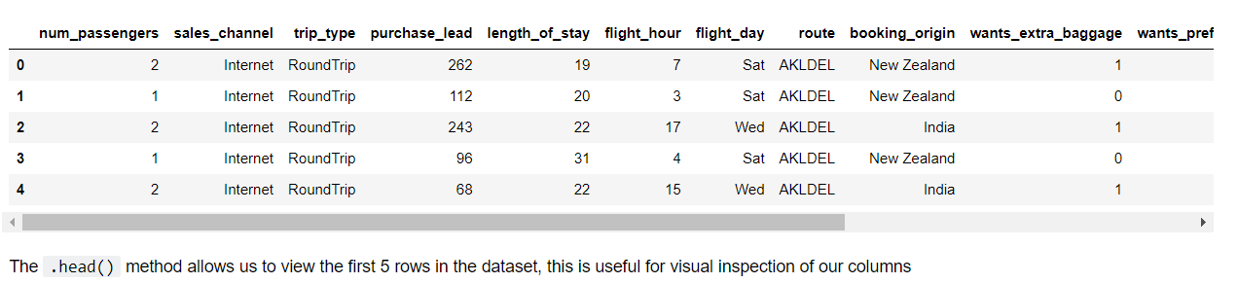
Predictive modeling of customer bookings
This Jupyter notebook includes some code to get you started with this predictive modeling task. We will use various packages for data manipulation, feature engineering and machine learning.
Exploratory data analysis

Slide 3
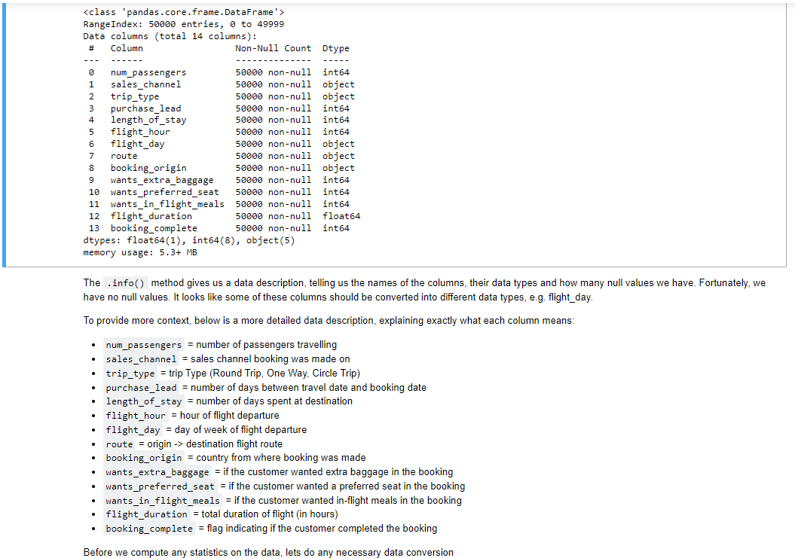
Info About Data

Slide 4
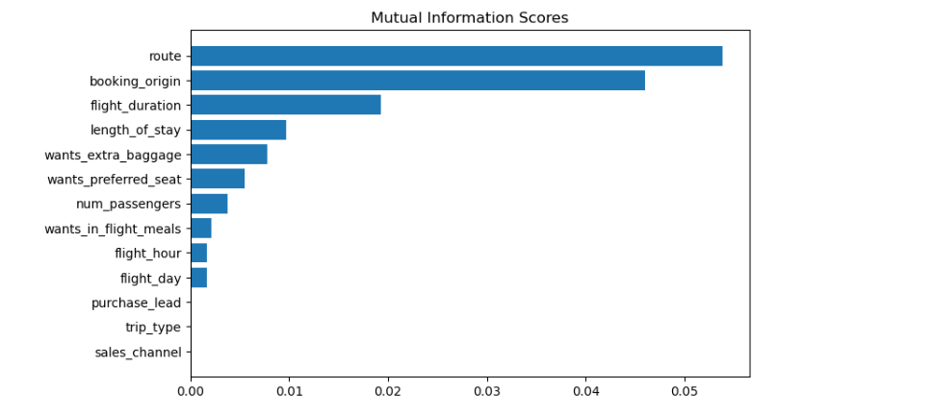
predictive model to understand factors that influence buying behaviour
We have trained the data set with XGB classifier, DecisionTree Classifier, Random forest classifier model and received Maximum
ACCURACY: 85.09
AUC score: 0.558
In the Random forest classifier model
route
booking_origin
flight_duration
wants_extra_baggage
length_of_stay
are the top 5 features which influence
Customer buying behavior
We need to increase the AUC score.

